Slide 1

How to Disagree
But Still Be Agreeable
OpenWest 2015
Robert Stone
BrainStorm Incubator

Slide 2
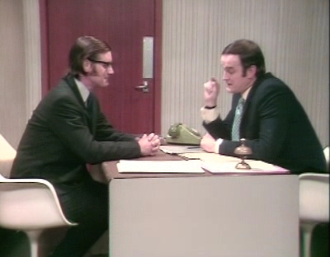
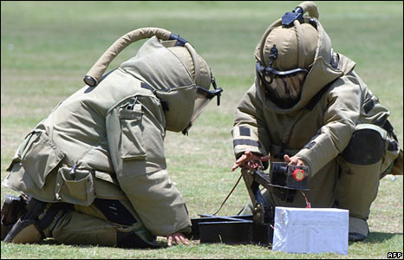
Overview
What is an Argument?
  Components of an Argument
  Reasons People Disagree
Strategies For Healthy Debate
  Identify, Avoid and Address Logical Fallacies
  Support With Facts
  Use the Right Words
Defusing A Tense Situation
  Keeping an Open Mind
  How and When to Empathize
  Keeping Your Cool
Questions
Monty Python – Argument Clinic
British Broadcasting Corporation

Slide 3

Argument - Components
Oxford Pocket Dictionary Definition
  “A reason or set of reasons given with the aim of persuading others that an action or idea is right or wrong”
Types of Arguments
  Formal
  Informal
Amazon

Slide 4
Argument - Components
Claim
Evidence
Counter Claim
Claim
  A Position
  Provable
  NOT an opinion
  Supported By Evidence
Evidence
  Facts
  Research
  Parallels
Counter Claim
  Opposing Positions
  Acknowledged and Refuted

Slide 5
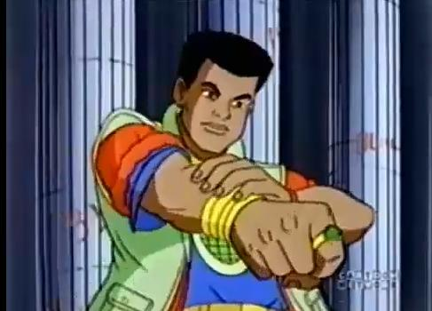


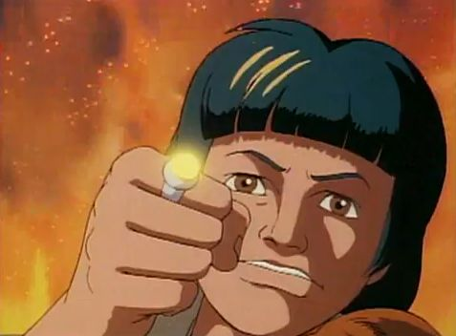


Argument – Reasons People Disagree
Why do people disagree?
  Different Experiences
  Different Skill Sets
  Different Values
  Different Priorities
  Different Communication Skills
DIFFERENT
  A Team’s Greatest Strength
Captain Planet

Slide 6
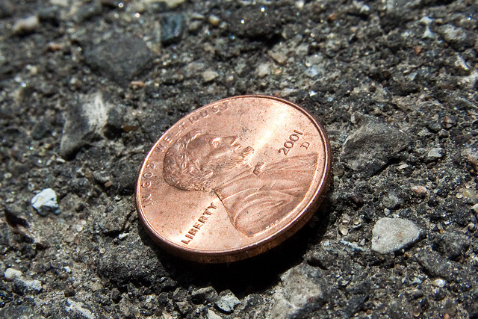
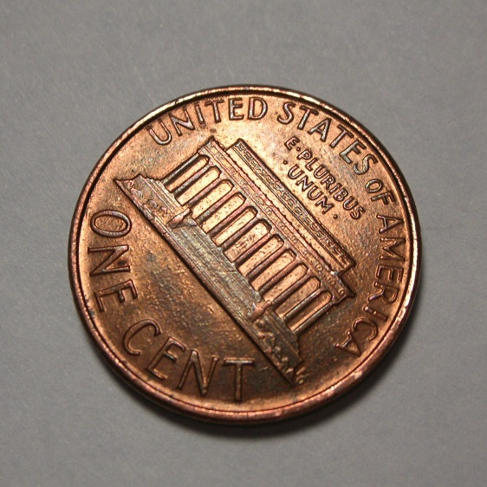
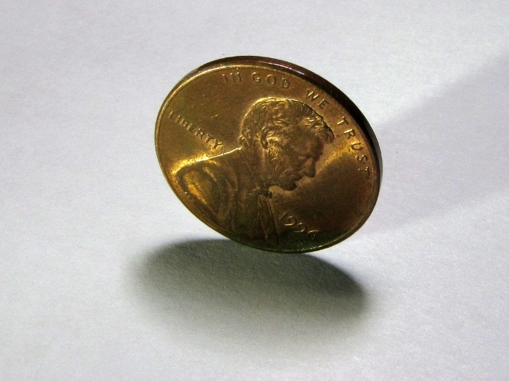
Healthy Debate - Logical Fallacies
False Dichotomy
  Only two possible solutions
Flickr – Steven Depolo
pixgood
Flickr - MagnuMicah

Slide 7
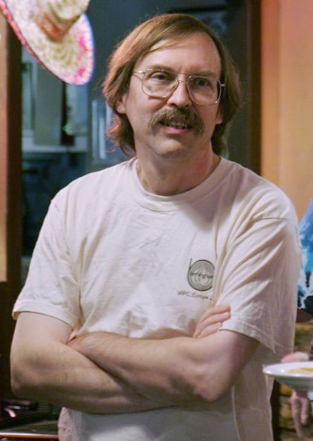
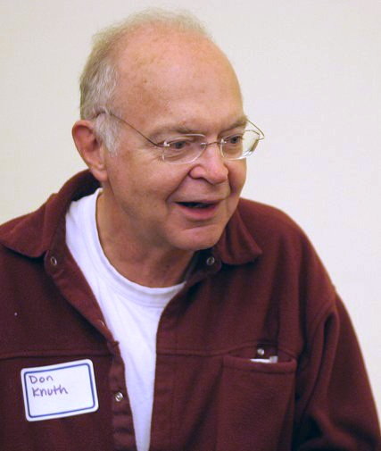
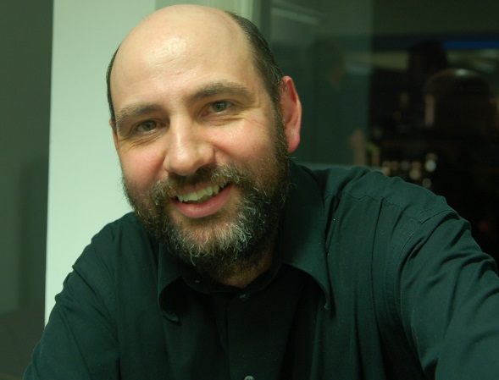
Healthy Debate - Logical Fallacies
False Dichotomy
  Only two possible solutions
Appeal to Authority
  All Hail Larry Wall / Donald Knuth / Martin Fowler
Wikipedia
Wikipedia
Ade Osineye

Slide 8
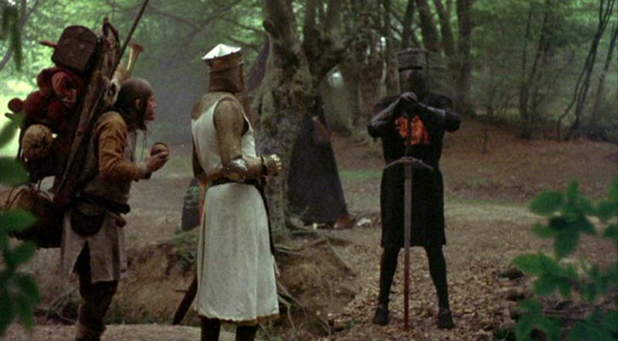
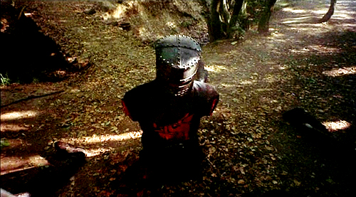
Healthy Debate - Logical Fallacies
False Dichotomy
  Only two possible solutions
Appeal to Authority
  All Hail Larry Wall / Donald Knuth / Martin Fowler
Ad Hominem
  “To The Man”
  Attacking the Person and not the Evidence
Monty Python – Holy Grail
Monty Python – Holy Grail

Slide 9

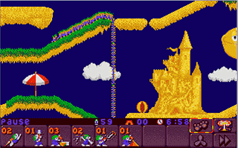
Healthy Debate - Logical Fallacies
False Dichotomy
  Only two possible solutions
Appeal to Authority
  All Hail Larry Wall / Donald Knuth / Martin Fowler
Ad Hominem
  “To The Man”
  Attacking the Person and not the Evidence
Bandwagon
  Everyone else does it this way
103.7 Q Country
Lemmings - PC

Slide 10
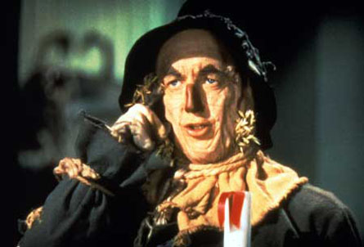
Healthy Debate - Logical Fallacies
False Dichotomy
  Only two possible solutions
Appeal to Authority
  All Hail Larry Wall / Donald Knuth / Martin Fowler
Ad Hominem
  “To The Man”
  Attacking the Person and not the Evidence
Bandwagon
  Everyone else does it this way
Straw Man
  Distorting a claim and attacking that position
Wizard of Oz
Notes:
So and so doesn’t think we should use NodeJS for this project. I don’t understand why he wants the website to run slowly.

Slide 11
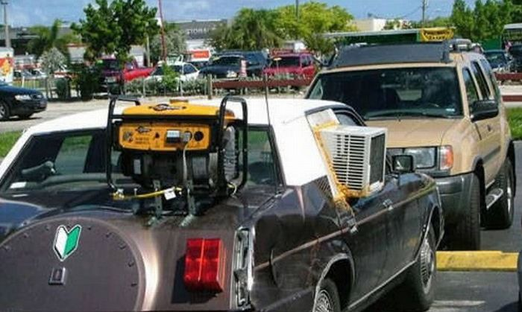
Healthy Debate - Logical Fallacies
False Dichotomy
  Only two possible solutions
Appeal to Authority
  All Hail Larry Wall / Donald Knuth / Martin Fowler
Ad Hominem
  “To The Man”
  Attacking the Person and not the Evidence
Bandwagon
  Everyone else does it this way
Straw Man
  Distorting a claim and attacking that position
Fallacy of Fallacies
  Just because the method is invalid doesn’t mean the claim is.
sarcasticsarcasms.blogspot.com

Slide 12
Healthy Debate – Avoiding Logical Fallacies
False Dichotomy
  Present a third option
Appeal to Authority
  Ask why the authority feels that way
Ad Hominem
  Steer the discussion back
  Provide additional evidence
Bandwagon
  Ask why everyone is doing it
Straw Man
  Reiterate the original claim
Be Aware Of Them
Subtly Point Them Out
  But don’t identify them by name!
  How to address them?
  Naturally develops better argument skills
DEMAND (politely) evidence
  Not just of others, of yourself

Slide 13
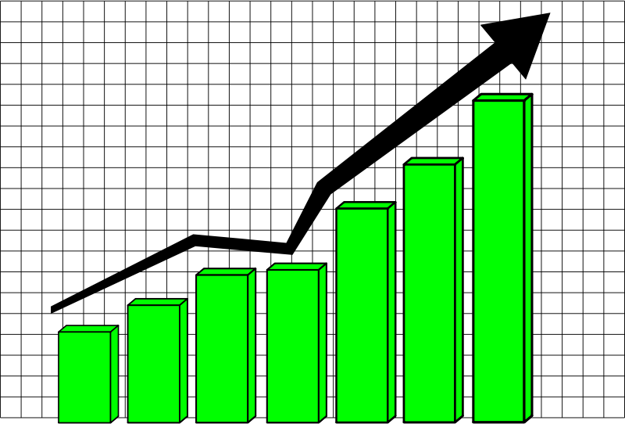

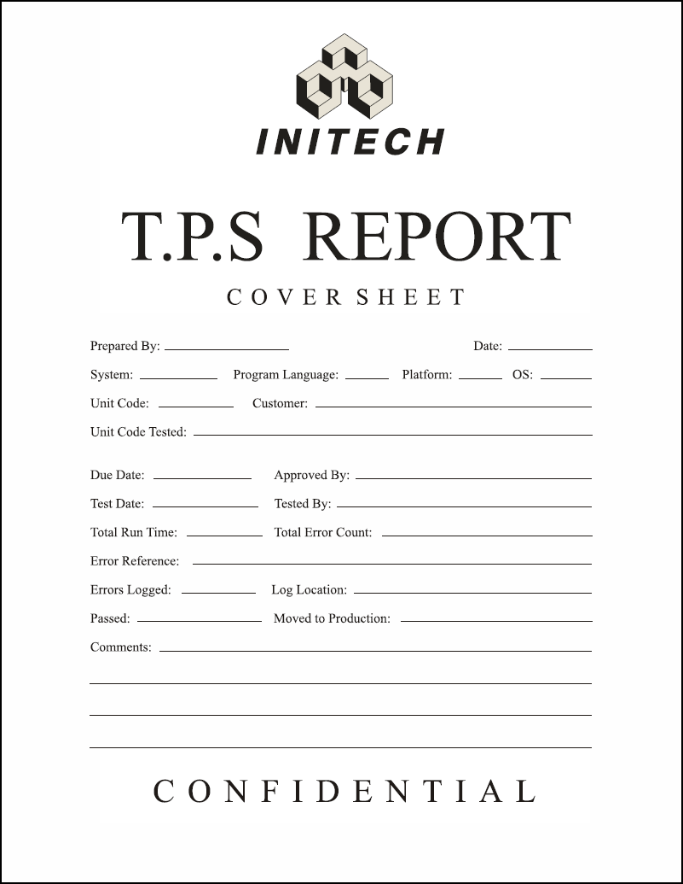
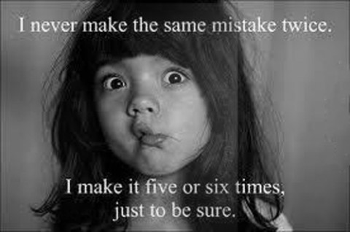
Healthy Debate – Support With Facts
Claims must be supported with evidence
Types of Evidence
  Numbers / Statistics
  Physical
    Can be observed or demonstrated
  Documentary
    Policies
    User Stories
    Acceptance Criteria
  Anecdotal
    Experience and Example
beliefmakers.blogspot.com
Office Space

Slide 14
Healthy Debate – Use The Right Words
Words have Connotations
  “An idea or feeling that a word invokes in addition to it’s literal or primary meaning”
Loaded Word | Example | Connotation
Wrong | That’s the wrong way to do this… | The person proposing is wrong
Stupid | That is a stupid solution | The person proposing is stupid
Broken | The implementation is broken | The creator is terrible
Just | Can’t you just refund the invoice? | The objection is trivial
Loaded Word | Example | Connotation
Right | The right way to do this is to… | All other solutions are wrong
Smart | The smart solution is… | Proposer is smarter than everyone
Fix | We can fix the implementation by… | The implementation is broken
Easy | Isn’t it easy to refund the invoice? | The objector is lazy

Slide 15

Defusing a Tense Situation – Keep an Open Mind
What is an “Open Mind?”
Benefits
  Additional Points of View
  Shared Responsibility and Workload
  Learning Opportunities
Great, but how?
  Embrace Intellectual Curiosity
  Ask Open Ended Questions
  Be Patient and Respectful
  Be Honest
University of St Andrews

Slide 16

Defusing a Tense Situation - Empathize
Understand and Share the Feelings of Another
  Put yourself in their shoes
  Why do they feel the way they feel?
Empathize, Don’t Sympathize
  What’s the difference?
  Why is it bad to Sympathize?
Use Feeling Words
  “I Think” vs “I Feel”
  Create an Emotional Connection to support your Logic Based Argument
  Avoid appeals to Emotion
Star Trek TNG

Slide 17

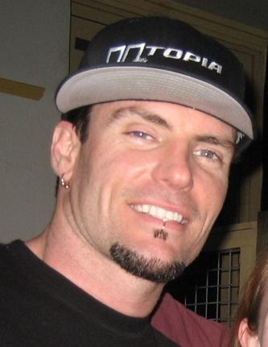
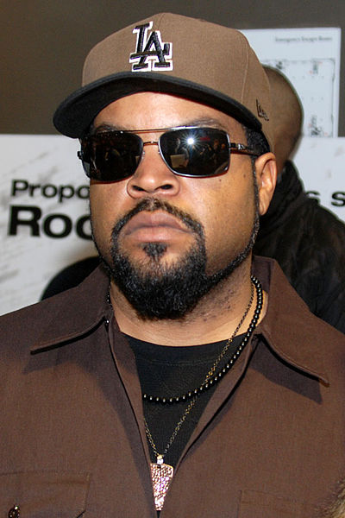

Defusing a Tense Situation – Keep Cool
Why Is it Important to Keep cool?
Strategies
  Don’t Take it Personally
  Be Aware of your Thoughts and Feelings
  Use Humor
  Take a Break
  Bring Reinforcements
lewing@isc.tamu.edu
Dave Kleinschmidt
Adam Bielawski
Flickr - Vicky

Slide 18
Defusing a Tense Situation – Shutting Down / Abstaining
Difference between “compromise” and “shutting down”
  Compromise
  Shutting Down
Consequences of Shutting Down
Difference between “choosing your battles” and “abstaining”
  Choosing your Battles
  Abstaining
Consequences of Abstaining

Slide 19
Questions

Slide 20
References and Further Reading
http://blog.smartbear.com/development/how-to-disagree-without-being-disagreeable/
http://drsanity.blogspot.com/2006/04/strategies-for-dealing-with-denial_14.html

