Slide 1
From OverTheWallOps to DevOps
Using OpenShift for SysOps and Engineering
May 9th, 2019 – Houston Perl Mongers
Shaun Ladewig, Systems Architect
Robert Stone, Advisory Engineering
Endurance International Group

Slide 2

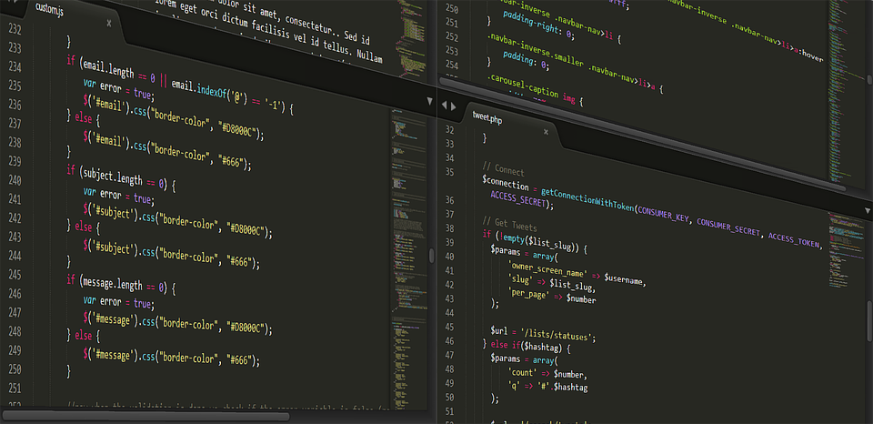
Overview
Infrastructure (Ops)
  Why OpenShift?
  Parts of OpenShift
  Planning your cluster
  Maintenance
  Troubleshooting Common Issues
OpenShift Usage (Dev)
  High Level Overview
    How the Pieces Fit Together
  Step by Step
    Components in Depth
  Real World
    Migrating from Existing to “The New Hotness”

Slide 3






Why OpenShift?
Get Started Fast
Kubernetes under the hood
Infrastructure as YAML/JSON
Ease of Use
  Interfaces
  Tagging
Containers all the way down
Staples
Guillaume Bolduc
okd.io
Notes:
It's easy to spin up (and tear down, and spin up, and tear down...)
It is Kubernetes under the hood
You enjoy expressing everything as YAML/JSON!
Easy to tag stuff so that you can use the right resources
Easy interfaces to get you going (and then can use more complex stuff if needed going forward)
Containers all the way down!

Slide 4
Parts of OpenShift
Master Node
Master Nodes
  Kubernetes APIs/Scheduler
  etcd
  Webconsole!
Infra Nodes
  Routers (default HAProxy)
  Shared Services
    (Monitoring, Registry)
Compute Nodes
  Where your apps will go
API/Auth
Data Store
Scheduler
Mgmt/Rep
Infra Node
Compute Node
Pod 0
Pod 0
Pod 1
Pod 1
Pod X
Pod X

Slide 5


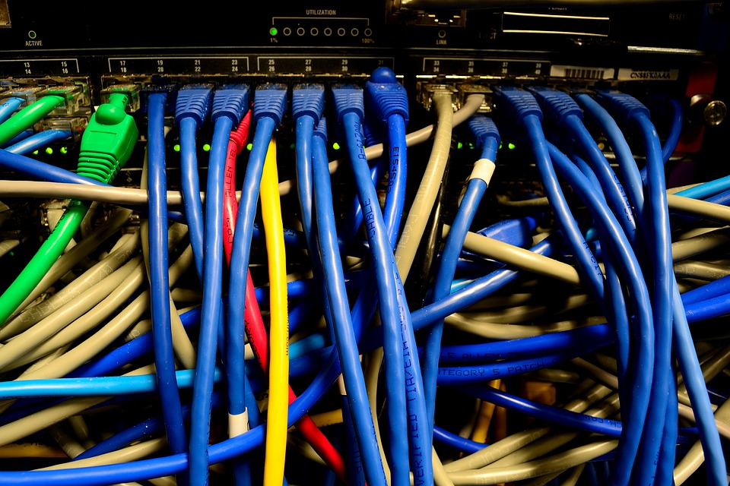
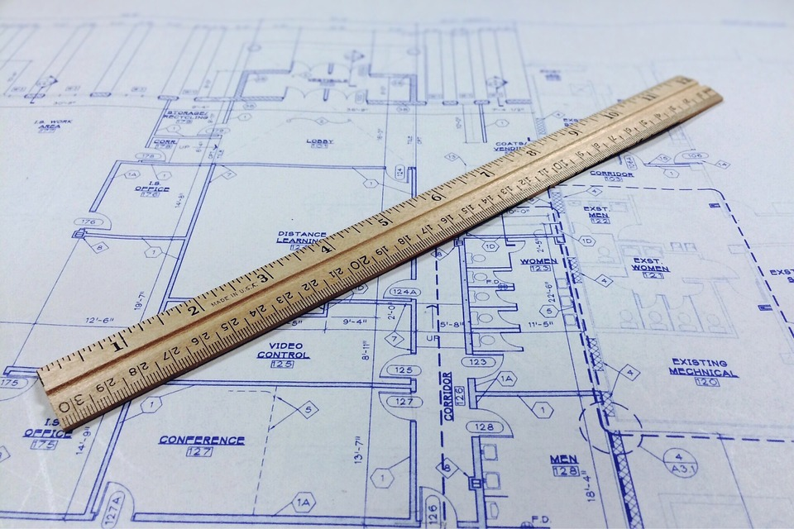
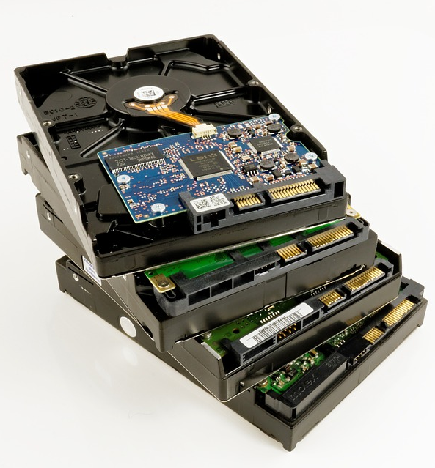
Planning your 1st Cluster I (on-prem edition)
OpenShift 3.11
Operating System
  Nodes
  Hypervisior
Upfront Considerations
  Consider Carefully!
  Physical Layout
    Mmmmm... compliance
  Network Plugin
  osm_cluster_network_cidr
  Storage
    Type
    Location

Slide 6
Planning your 1st Cluster II
HW-Node1
HW-Node2
HW-Node3
HW-Node4
OS-nat1
OS-infra1
OS-compute-dev1
OS-compute-prod1
OS-infra-router1
OS-master1
OS-compute-dev2
OS-compute-prod2
OS-master-lb1
HW-Node5
HW-Node6
HW-Node7
HW-Node8
OS-nat2
OS-infra2
OS-compute-dev3
OS-compute-prod3
OS-infra-router2
OS-master2
OS-compute-dev4
OS-compute-prod4
OS-master-lb2

Slide 7


Maintenance
Cleanup / Pruning
  Registry
  Projects
Backups
  etcd node
  configs
Monitoring
  Alerts sent somewhere YOU WILL WATCH!
Upgrading nodes
  If using ansible, git pull branch, and run upgrade
Notes:
Clean up the registry!
Backups of etcd node/configs
If you make it so that dev can spin up whatever, clean up!
Make sure the alerts go somewhere YOU WILL WATCH!
Upgrading nodes
If using ansible, git pull branch, and run upgrade

Slide 8
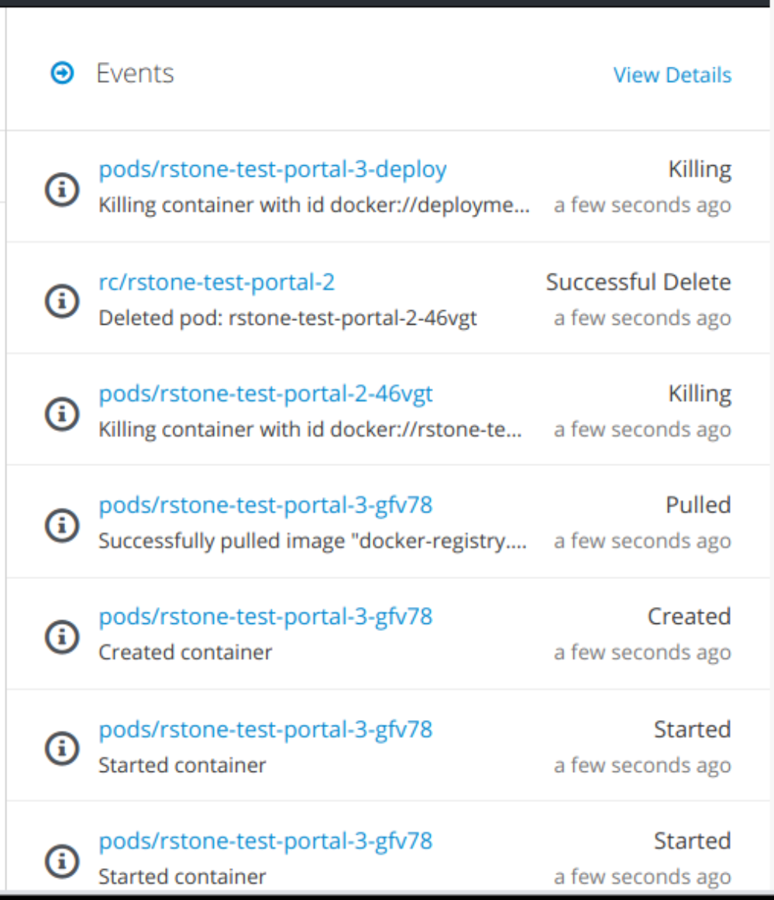
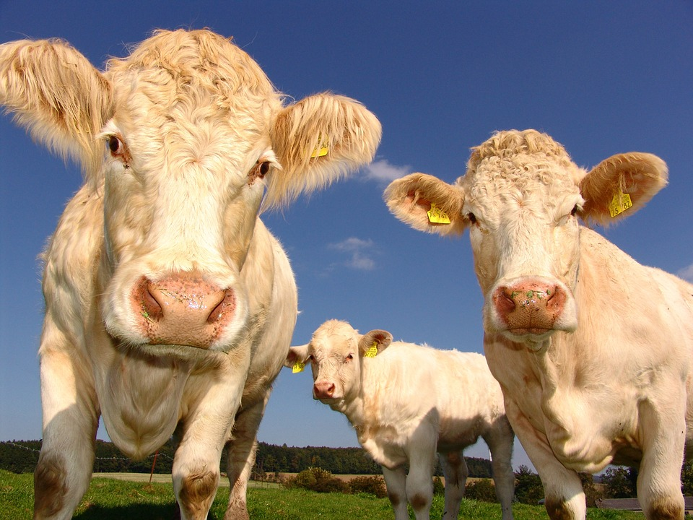

Troubleshooting Common Issues
The Events Page
  First place to look
Cattle not Pets
  If you used atomic, and the node is dead…
  Delete the node, reload, and scale-up
    GlusterFS
Notes:
First Place to Look
The events page! (or more so point the folks spinning things up to that)
If you used atomic, and the node is dead... delete the node (not gluster volume), reload, scale-up

Slide 9
High Level Overview
Secret
Secret
Docker Image
Service
Build Config
Build Config
Container
Container
POD
Route
Deployment Config
Image Stream
Image Stream

Slide 10
High Level Overview
Secret
Secret
Docker Image
Service
Build Config
Build Config
Container
Container
POD
Route
Deployment Config
Image Stream
Image Stream

Slide 11
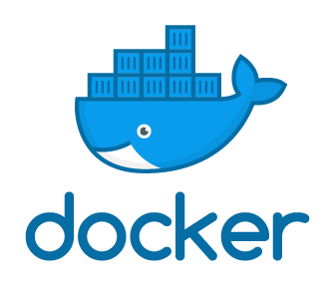




Docker Image
What is it?
  The Operating System
  (And sometimes more!)
Based on an Upstream Image
Why?
  Upstream Updates
  Security Fixes/Patches
docker.com
Cameron Kirby

Slide 12
High Level Overview
Secret
Secret
Docker Image
Service
Build Config
Build Config
Container
Container
POD
Route
Deployment Config
Image Stream
Image Stream

Slide 13






Build Config I – Docker
Recipes for making an Image
Docker Build
  Got root?
Install rpms and other server applications
Setting Up the s2i Scripts
SOCIAL.CUT
Wikipedia
Jenkins.io

Slide 14
High Level Overview
Secret
Secret
Docker Image
Service
Build Config
Build Config
Container
Container
POD
Route
Deployment Config
Image Stream
Image Stream

Slide 15


Image Stream I - Builder
“git” for completed builds
  Collection of builds
Tagged
  Latest
  Version Numbers
Watchable
  Trigger downstream events
Viktor Talashuk

Slide 16
High Level Overview
Secret
Secret
Docker Image
Service
Build Config
Build Config
Container
Container
POD
Route
Deployment Config
Image Stream
Image Stream

Slide 17


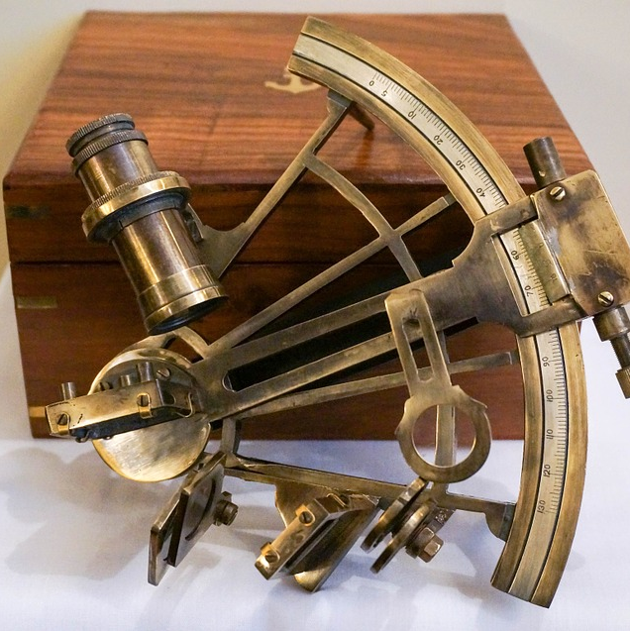
Build Config II – Source
Source Build
  s2i assemble
Incorporates Source Code
Runs as unprivileged user
“Puts stuff in the right place”
  Produces a runnable image

Slide 18
High Level Overview
Secret
Secret
Docker Image
Service
Build Config
Build Config
Container
Container
POD
Route
Deployment Config
Image Stream
Image Stream

Slide 19
Image Stream II - Source
Deployable Image
Managed using Tags
Development
Staging
Production
  Development Secrets
  Production Secrets
  Not Customer Accessible
  Production Secrets
  Customer Accessible

Slide 20
High Level Overview
Secret
Secret
Docker Image
Service
Build Config
Build Config
Container
Container
POD
Route
Deployment Config
Image Stream
Image Stream

Slide 21
The Running App I – Deployment Config
Container(s)
  s2i run
Mounts
  Secrets
  Config
  Volumes
Environment
POD
Secret
Secret
Container
Container
POD
Deployment Config

Slide 22



The Running App II – Deployment Config
Resource Allocation
  CPU
  Memory
Health Checks
  Liveness Probe
  Readiness Probe
Triggerable
Versioned
Notes:
Liveness Probe (Still running, reap if not) and Readiness Probe (Ready to Serve Requests, out of load balancer if not)

Slide 23
High Level Overview
Secret
Secret
Docker Image
Service
Build Config
Build Config
Container
Container
POD
Route
Deployment Config
Image Stream
Image Stream

Slide 24
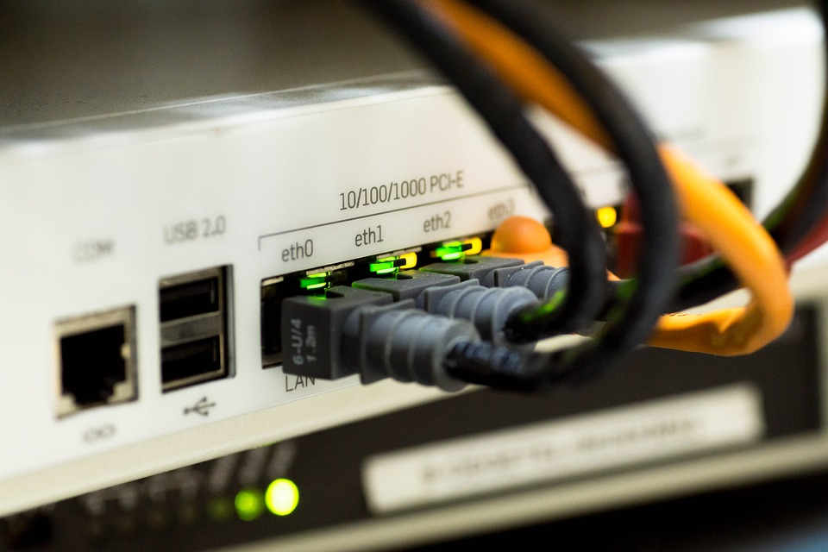


Networking
Service
  Internal Connectivity
  Internal Load Balancer
  Proxy to Pods
Route
  External Connectivity
  Exposes a Service
    Via a Hostname
  TLS Termination

Slide 25
Migrating To Container Based
Secret
Secret
Docker Image
Service
Build Config
Build Config
Container
Container
POD
Route
Deployment Config
Image Stream
Image Stream

